Slide 1
Fake News Detection
A presentation by:
Shefali Mevada

Slide 2
Abstract
Authenticity of Information has become a longstanding issue affecting businesses and society, both for printed and digital media.
On social networks, the reach and effects of information spread occur at such a fast pace and so amplified that distorted, inaccurate, or false information acquires a tremendous potential to cause real-world impacts, within minutes, for millions of users.

Slide 3
Problem:
The proliferation of fake news on social media and internet is deceiving people to an extent which needs to be stopped.

Slide 4
Our goal is to develop a reliable model that classifies a given
News article as either Fake or Real.

Slide 5
Introduction
Fake news has been around for decades and is not a new concept. However, the down of the social media age has aggravated the generation and circulation of fake news many folds. Fake news can be simply explained as a piece of article which is usually written for economic, personal or political gains.

Slide 6
Is it a global challenge?
Examples of such websites, may be found in Ukraine, United States of America, Germany, China and lots of other countries. Thus, Fake News is a Global issue as well as a Global Challenge.

Slide 7
Problem Statement
The Main Objective is to generate a model that can discriminate between “FAKE” and “REAL” news articles when it is trained with a certain datastet.

Slide 8
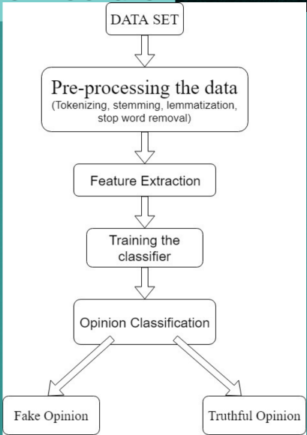
System Architecture

Slide 9
Expected Output
The model must efficiently distinguish between True News and Fake News with maximum Accuracy.

Slide 10
Conclusion:
In the 21st century, majority of the tasks are done online. Newspaper who were earlier preferred as hardcopies are now being substituted by applications like Face book, Twitter and news articles to be read online.

Slide 11
The growing problem of fake news only makes things more complicated and tries to change or hamper the opinion and attitude of people towards use of digital technology.

Slide 12
Our systems take input form a URL or an existing database and classify it to be Real or Fake. To implement this, various NLP and Machine Learning Techniques have to be used.

Slide 13
Thank You

